Slide 1
Programming with Python
Day 3

Slide 2
Definite Iteration: The for Loop
Repetition statements (or loops) repeat an action
Each repetition of action is known as pass or iteration
Two types of loops
Those that repeat action a predefined number of times (definite iteration)
Those that perform action until program determines it needs to stop (indefinite iteration)

Slide 3
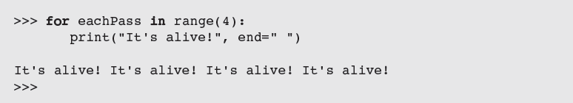
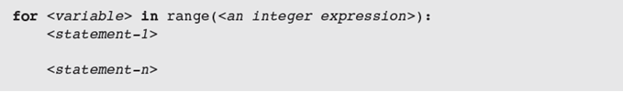
Executing a Statement a Given Number of Times
Python’s for loop is the control statement that most easily supports definite iteration
The form of this type of loop is:
loop header
loop body
statements in body must be indented and aligned in the same column
How is this different from JAVA “for” loop?

Slide 4
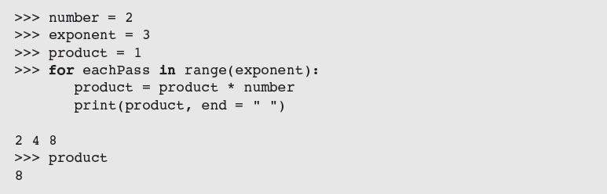
Executing a Statement a Given Number of Times
Example: Loop to compute an exponentiation for a non-negative exponent
If the exponent were 0, the loop body would not execute and value of product would remain as 1

Slide 5
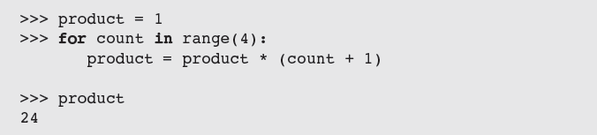
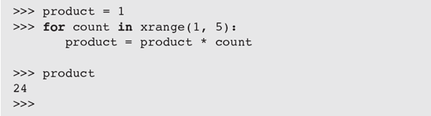
Count-Controlled Loops
Loops that count through a range of numbers
To specify a explicit lower bound:

Slide 6
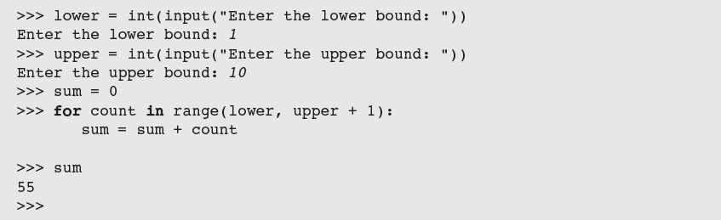
Count-Controlled Loops
Example: bound-delimited summation

Slide 7
Augmented Assignment
Augmented assignment operations:
Format:
Equivalent to:

Slide 8
Loop Errors: Off-by-One Error
What is the issue with the following loop?
This is not a syntax error, but rather a logic error

Slide 9
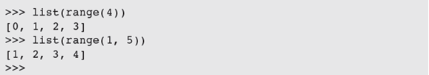

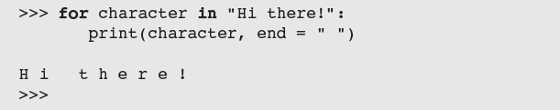
Traversing the Contents of a Data Sequence
range returns a list
Strings are also sequences of characters
Values in a sequence can be visited with a for loop:
Example:

Slide 10
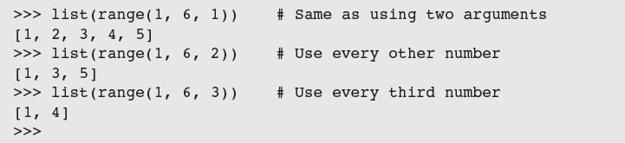
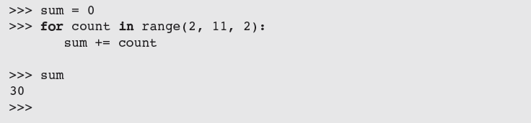
Specifying the Steps in the Range
range expects a third argument that allows you specify a step value
Example in a loop:

Slide 11
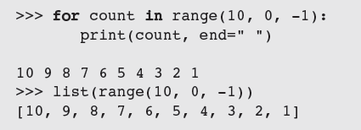
Loops That Count Down
Example:
How is this loop syntax different from the Java loop syntax?

Slide 12
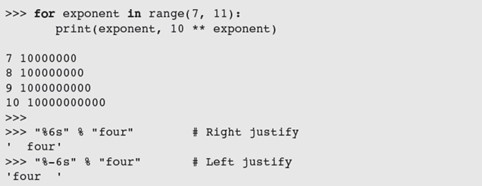
Formatting Text for Output
Many data-processing applications require output that has tabular format
Field width: Total number of data characters and additional spaces for a datum in a formatted string

Slide 13
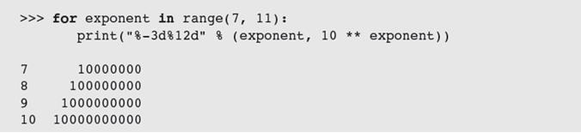
Formatting Text for Output
This version contains format string, format operator %, and single data value to be formatted
To format integers, letter d is used instead of s
To format sequence of data values:

Slide 14
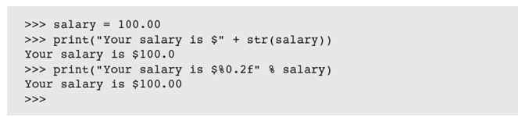
Formatting Text for Output
To format data value of type float:
where .<precision> is optional
Examples:

Slide 15
Case Study: An Investment Report
Request:
Write a program that computes an investment report

Slide 16
Case Study: An Investment Report
Analysis:

Slide 17
Case Study: An Investment Report
Design:
Receive the user’s inputs and initialize data
Display the table’s header
Compute results for each year and display them
Display the totals

Slide 18
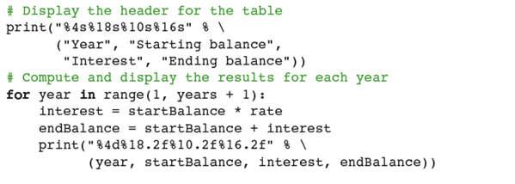

Case Study: An Investment Report
Coding
(read and explain each line of code)

Slide 19
The Boolean Type, Comparisons, and Boolean Expressions
Selection statements allow a computer to make choices based on a condition
Boolean data type consists of two values: true and false (typically through standard True/False)
Example: 4 != 4 evaluates to False

Slide 20
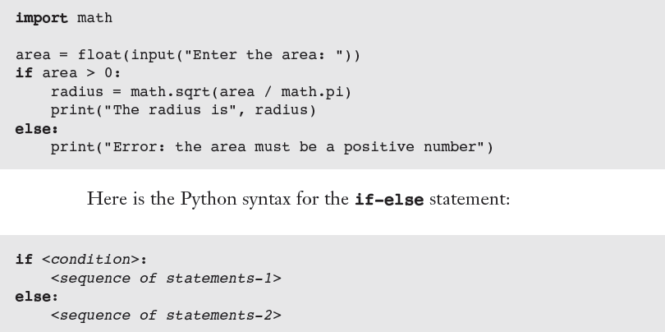

if-else Statements
Also called a two-way selection statement
Often used to check inputs for errors:
Syntax:

Slide 21
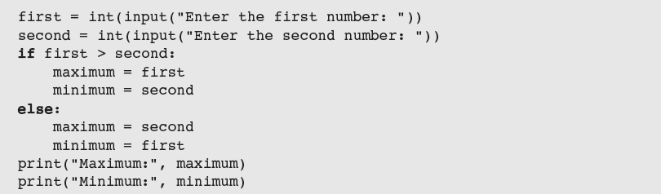

if-else Statements (continued)
must be a Boolean expression
Better alternative:

Slide 22
One-Way Selection Statements
Simplest form of selection is the if statement

Slide 23
Multi-way if Statements
A program may be faced with testing conditions that entail more than two alternative courses of action
Can be described in code by a multi-way selection statement

Slide 24
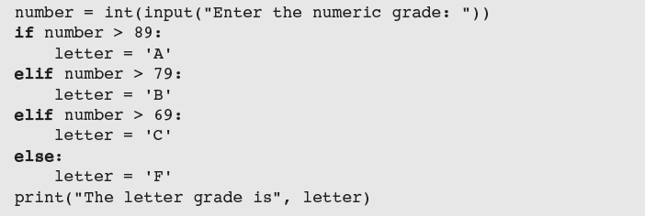
Multi-way if Statements
Syntax:

Slide 25
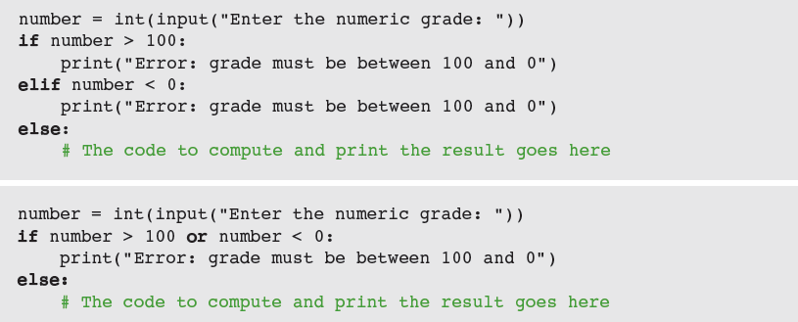
Logical Operators and Compound Boolean Expressions
Often a course of action must be taken if either of two conditions is true: Below are two approaches
Could we use the and logical operator instead?

Slide 26
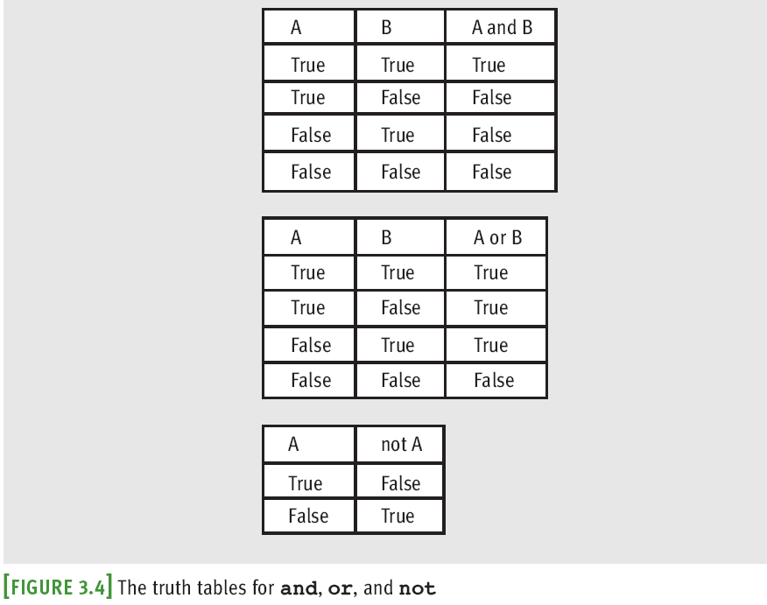
Logical Operators and Compound Boolean Expressions

Slide 27
Logical Operators and Compound Boolean Expressions
Next example verifies some of the claims made in the previous truth tables:
The logical operators are evaluated after comparisons but before the assignment operator
not has higher precedence than and and or

Slide 28
Logical Operators and Compound Boolean Expressions

Slide 29
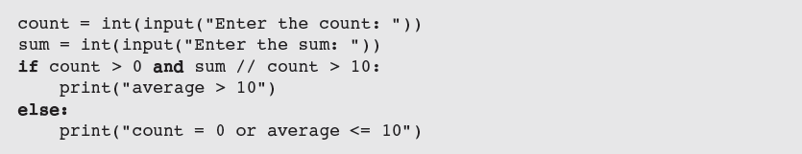

Short-Circuit Evaluation
In (A and B), if A is false, then so is the expression, and there is no need to evaluate B
In (A or B), if A is true, then so is the expression, and there is no need to evaluate B
Short-circuit evaluation: Evaluation stops as soon as possible

Slide 30
Testing Selection Statements
Tips:
Make sure that all of the possible branches or alternatives in a selection statement are exercised
After testing all of the actions, examine all of the conditions
Test conditions that contain compound Boolean expressions using data that produce all of the possible combinations of values of the operands

Slide 31
The Structure and Behavior of a while Loop
The while loop can be used to describe conditional iteration
Example: A program’s input loop that accepts values until user enters a sentinel that terminates the input
Conditional iteration requires that condition be tested within loop to determine if it should continue
Called continuation condition
Improper use may lead to infinite loop
while loop is also called entry-control loop
Condition is tested at top of loop
Statements within loop can execute zero or more times

Slide 32
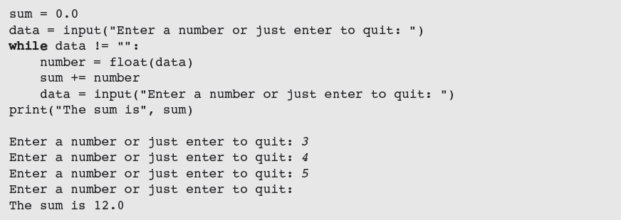
The Structure and Behavior of a while Loop
data is the loop control variable
Read the code above. What does each line of code do?

Slide 33
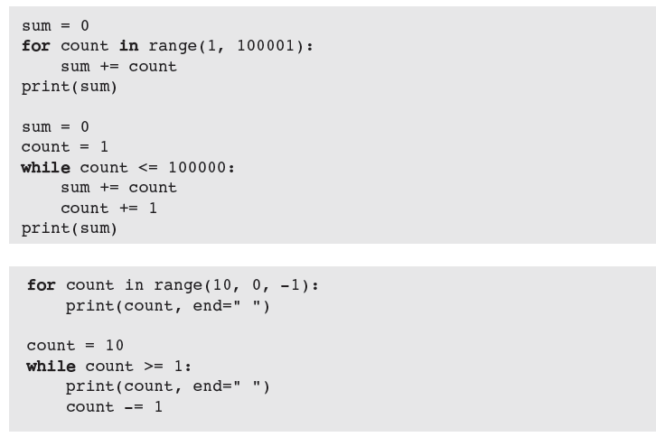
Count Control with a while Loop

Slide 34
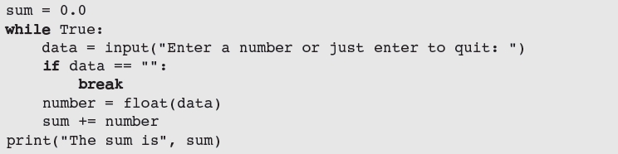
The while True Loop and the break Statement
while loop can be complicated to write correctly
Possible to simplify its structure and improve its readability

Slide 35
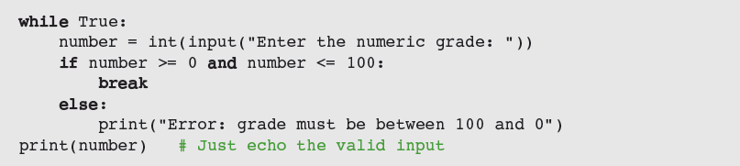
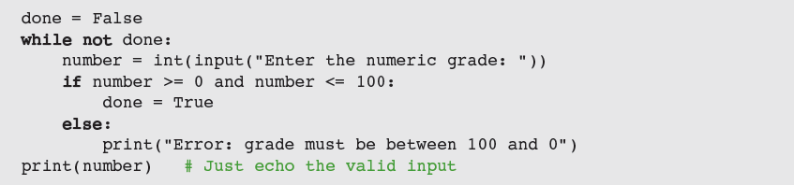
The while True Loop and the break Statement
Alternative: Use a Boolean variable to control loop

Slide 36
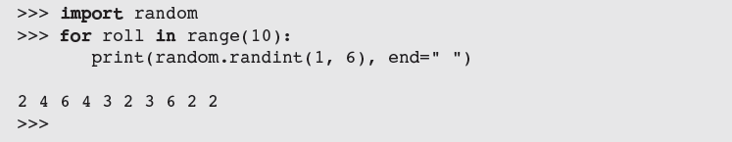
Random Numbers
Programming languages include resources for generating random numbers
random module supports several ways to do this
randint returns random number from among numbers between two arguments, included

Slide 37
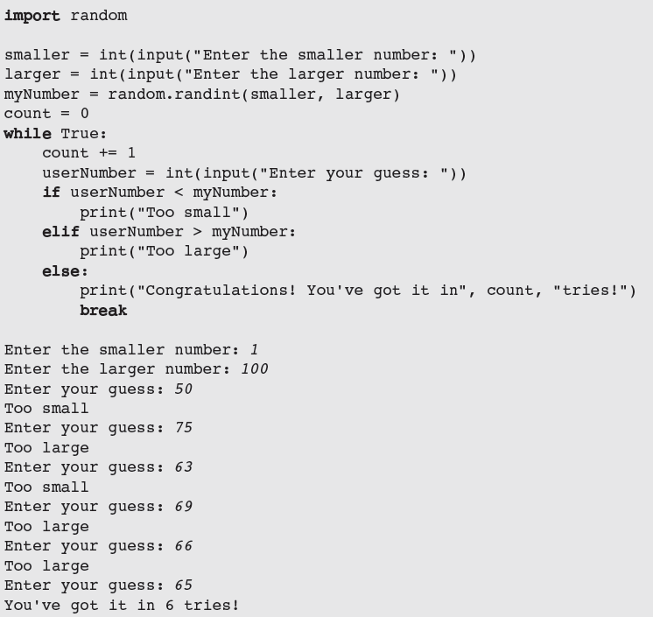
Random Numbers
What does each line of code do?

Slide 38
Loop Logic, Errors, and Testing
Errors to rule out during testing while loop:
Incorrectly initialized loop control variable
Failure to update this variable correctly within loop
Failure to test it correctly in continuation condition
To halt loop that appears to hang during testing, type Control+c in terminal window or IDLE shell
If loop must run at least once, use a while True loop with delayed examination of termination condition
Ensure a break statement to be reached eventually

Slide 39
Case Study: Approximating Square Roots
Request:
Write a program that computes square roots
Analysis:
Design:
Use Newton’s square root approximation algorithm:
Square root y of a positive number x is the number y such that y² = x
If initial estimate of y is z, a better estimate of y can be obtained by taking the average of z together with x/z

Slide 40
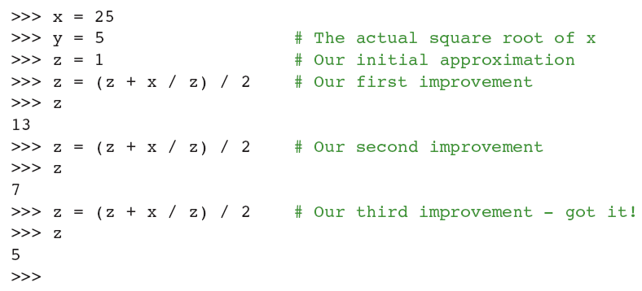
Case Study: Approximating Square Roots
A quick session with the Python interpreter shows this method of successive approximations in action:

Slide 41
Case Study: Approximating Square Roots
Design (continued): Algorithm
set x to the user’s input value
set tolerance to 0.000001
set estimate to 1.0
while True
set estimate to (estimate + x / estimate) / 2
set difference to abs(x - estimate ** 2)
if difference <= tolerance:
break
output the estimate

Slide 42
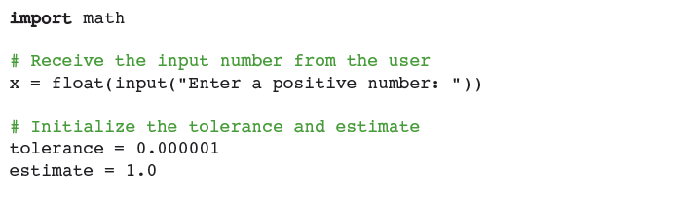
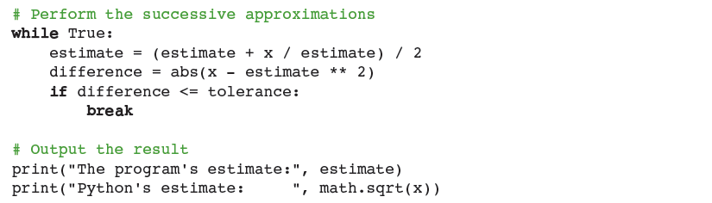
Case Study: Approximating Square Roots
Implementation (Coding)
Read and explain each line of code:

Slide 43
Summary
Control statements determine order in which other statements are executed in program
Definite iteration is process of executing set of statements fixed, predictable number of times
Example: use for loop
for loop consists of header and set of statements called body
Can be used to implement a count-controlled loop
Use range to generate sequence of numbers
Can traverse and visit the values in any sequence

Slide 44
Summary
A format string and its operator % allow programmer to format data using field width and precision
An off-by-one error occurs when loop does not perform intended number of iterations, there being one too many or one too few
Boolean expressions evaluate to True or False
Constructed using logical operators: and, or, not
Python uses short-circuit evaluation in compound Boolean expressions
Selection statements enable program to make choices

Slide 45
Summary
if-else is a two-way selection statement
Conditional iteration is the process of executing a set of statements while a condition is true
Use while loop (which is an entry-control loop)
A break can be used to exit a loop from its body
Any for loop can be converted to an equivalent while loop
Infinite loop: Continuation condition never becomes false and no other exit points are provided
random.randint returns a random number

